Slide 1


Error 404 Presentation Not Found

Slide 2
Error 404 Page not Found Shubham, Upal, Sam, Jishnu, Owen, Aditya, Nikki

Slide 3

Game Lore
You are stuck, trapped in a room. You figure out that it is an Escape Room because of your history with puzzles. You seem to be able to collect objects through various methods. The door will open once you collect all the objects, and you can get out. Something doesn’t make sense though, why is there another room outside your current room? Is there even an end to this? or is it all a bug and you’re just stuck in a never-ending cycle of escaping the escape rooms?

Slide 4

Game Lore
Spoilers alert, this game is not a never-ending cycle of escape rooms; however, it will feel like a never-ending game if you aren’t great with puzzles.
The game consists of 3 rooms, one outside the other. Each room has different methods of escape, and every room is as challenging as the other. The final key to the final room is key 404.
Will 404 finally be found? Let’s hope so.
Pre-Order 404 Page Not Found on Steam: store.steampowered.com/error-404

Slide 5
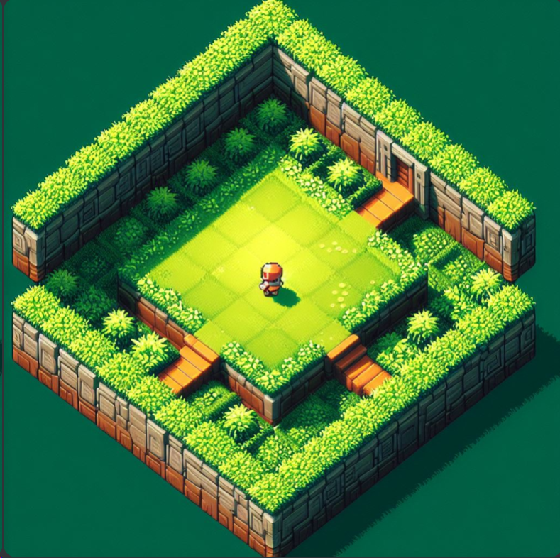
First Room🌳
This is the first room after starting the game. Blessed by mother nature, this grassy room isn't very creepy. There aren't any enemies, just a few bugs (no pun intended) and a puzzle to solve.

Slide 6

The impossible Puzzle!
Embark on a journey of mental mastery with our challenging puzzle game, where each level promises to push your problem-solving skills to their limits.

Slide 7
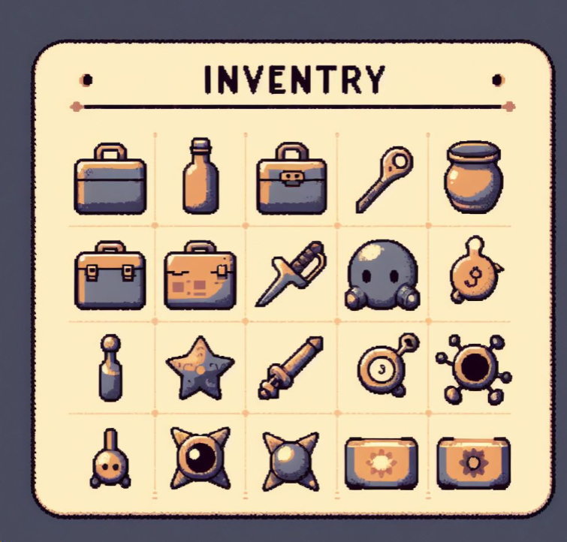
Inventory⚙️
This is your inventory; all your collected objects will be stored here. Why do you even need it? Well, some things are better left unexplained, that'll make playing the game more fun!
Press I in your keyboard to access it.

Slide 8
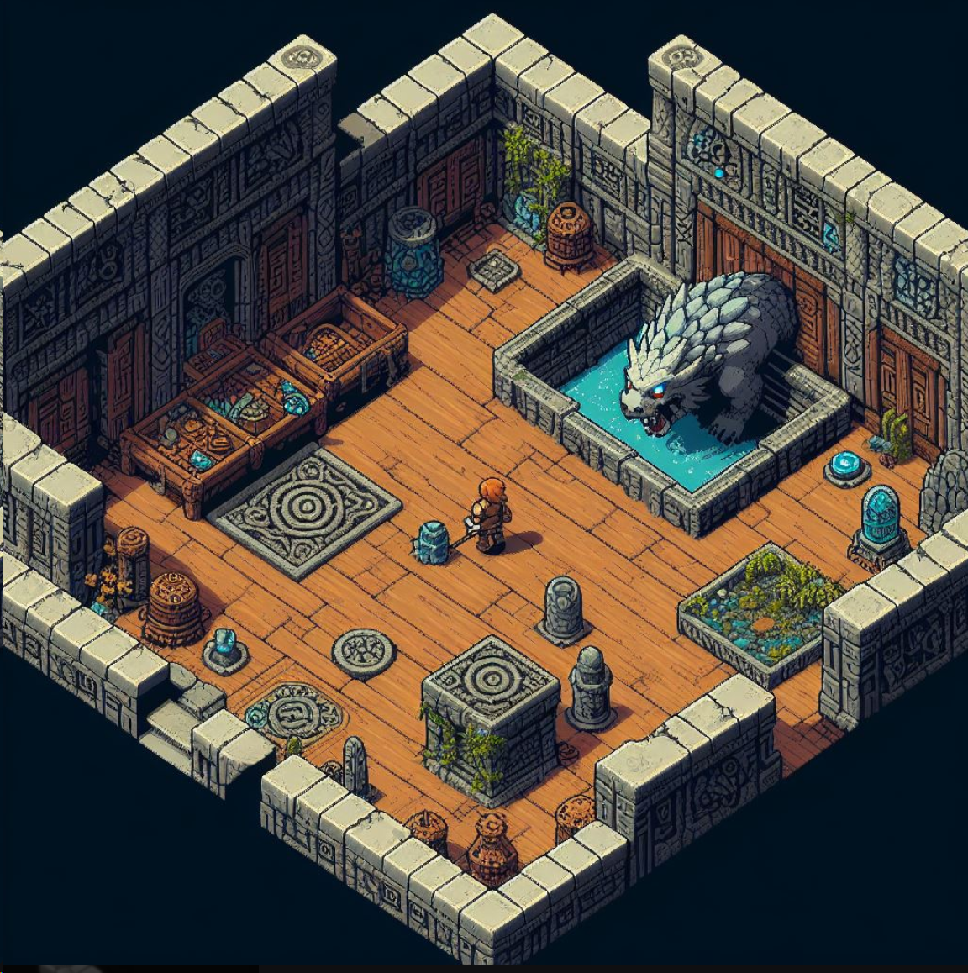
Second Room🗿
Alright you're out of the most peaceful room and now it's time for the second room. This mysterious room is filled with ancient relics.. and a monster!

Slide 9
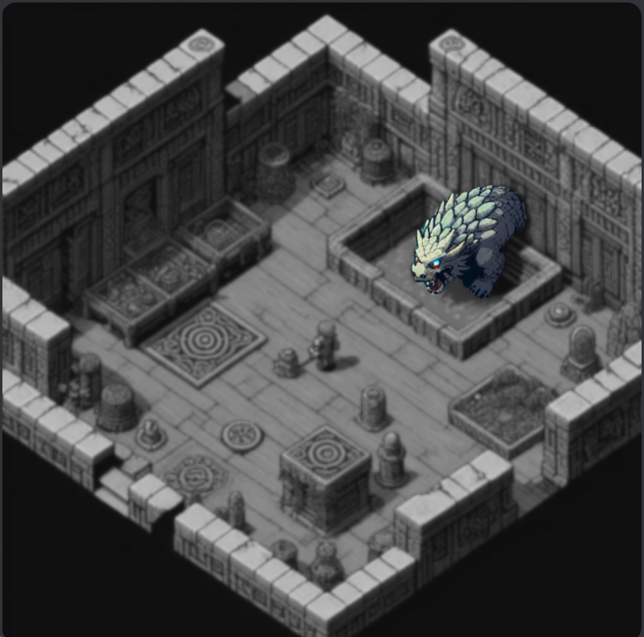
Enemy😈
Let's address the monster in the second room, that's your enemy. You must figure out a way to defeat that evil by using the given hints.

Slide 10
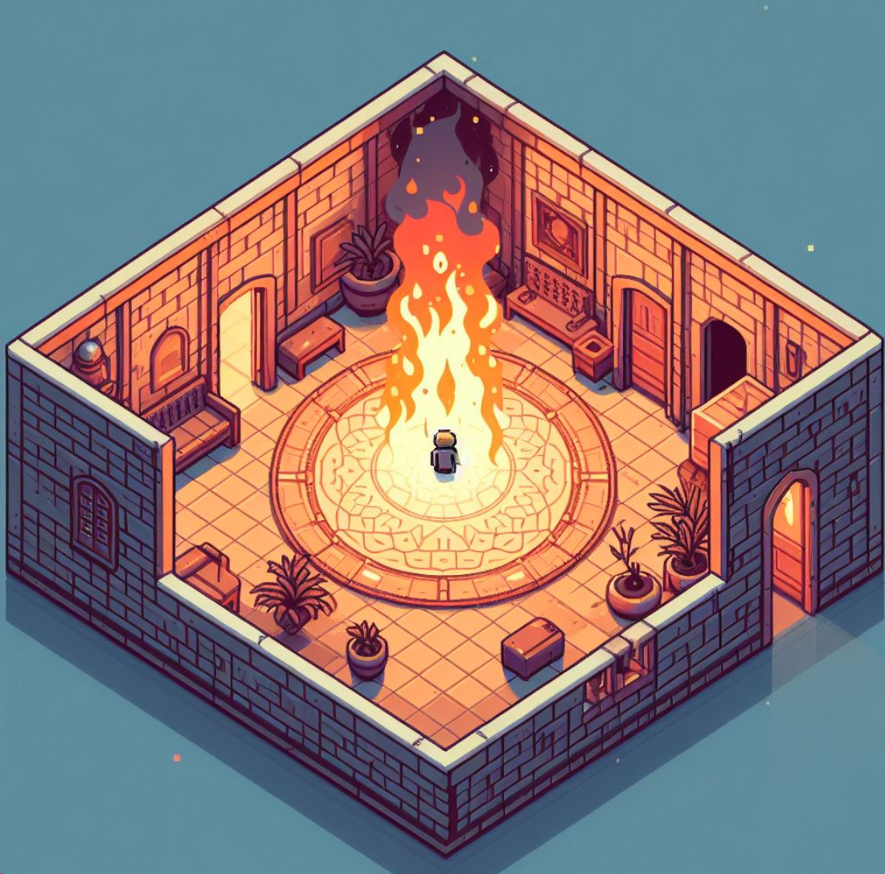
Third Room🔥
This room feels like hell, literally. Escaping this will be an actual nightmare. You must figure out a way to complete quizzes while also making sure that you're not BURNING.
❌Get stuck on a quiz for a long time and the fire WILL get you.

Slide 11

How much do you know about math, computers?!
Let’s see if you can beat our AI Guru! The game features an exciting quiz game. Questions are generated by AI powered by the GPT-4 Model. You are against AI to prove your with and win!

Slide 12
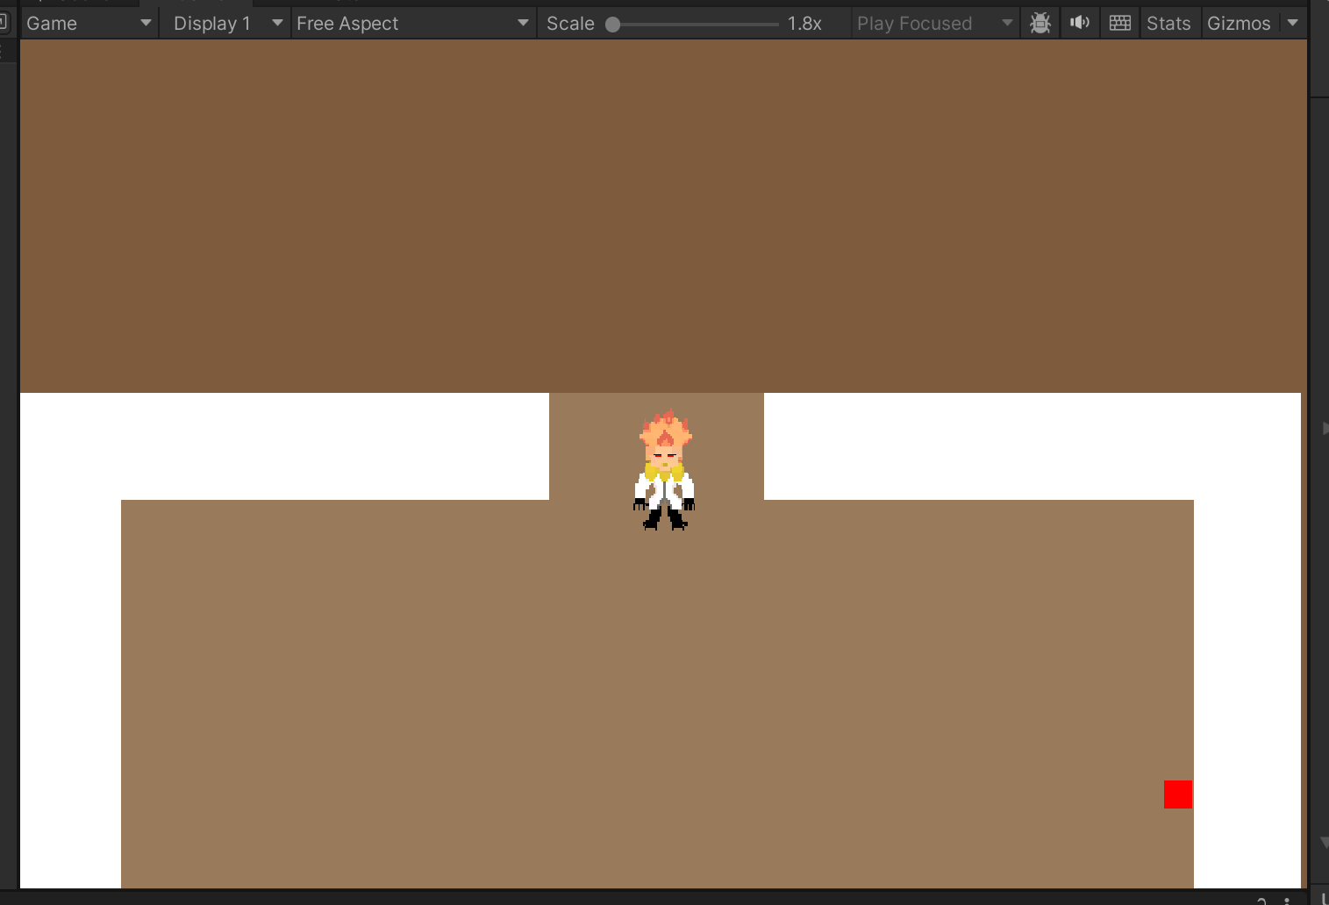
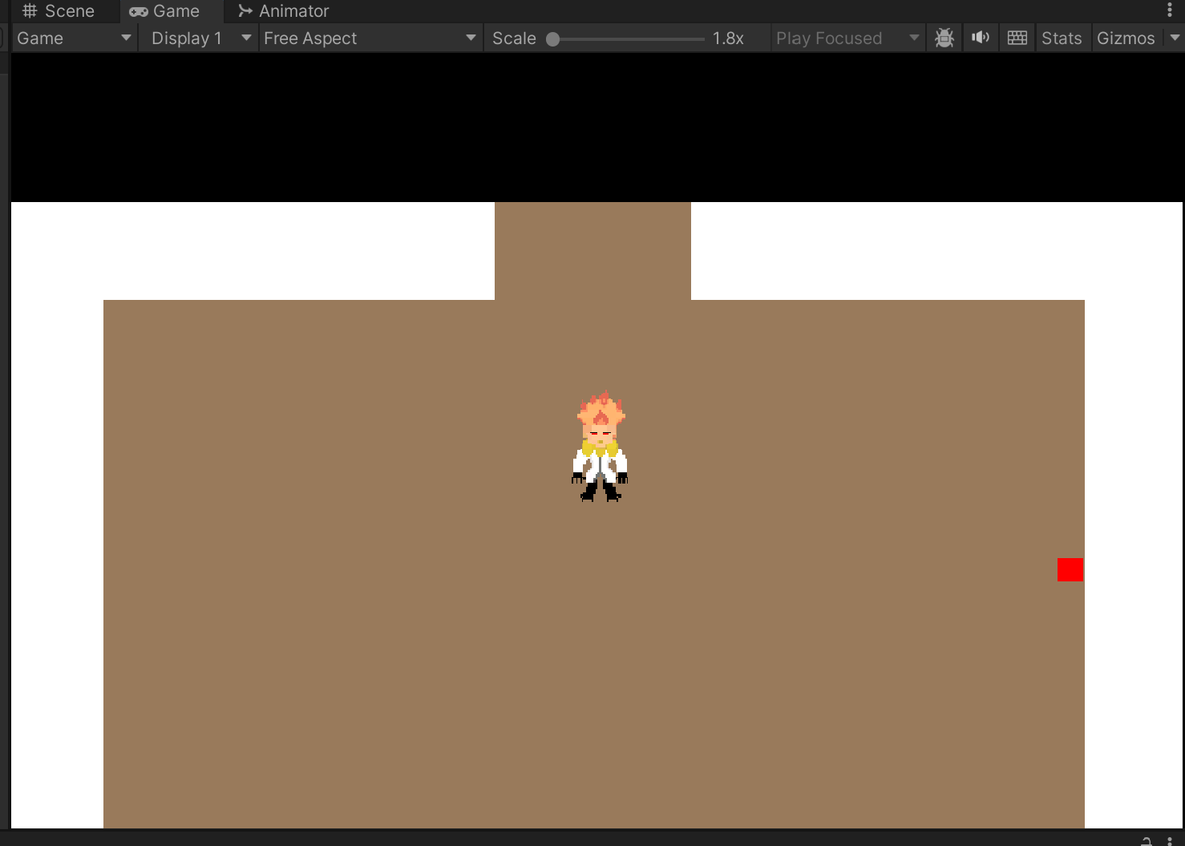
MVP Screenshots

Slide 13
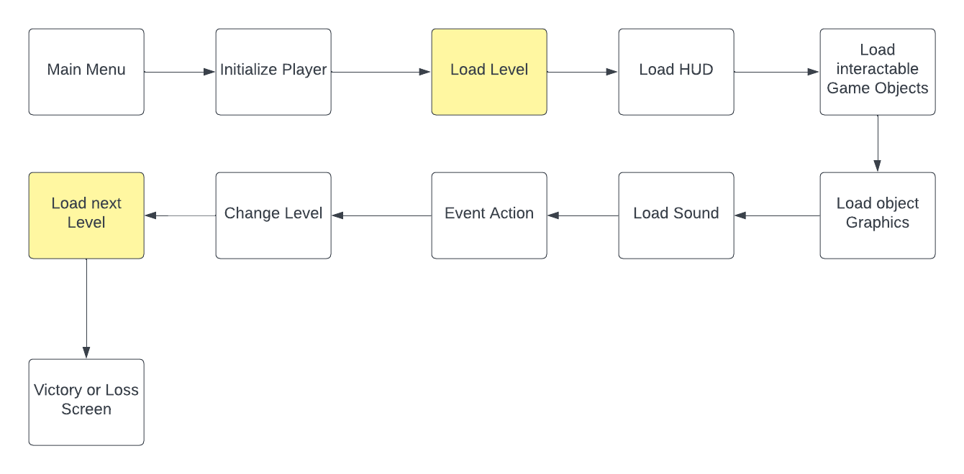
Global Use Case:

Slide 14
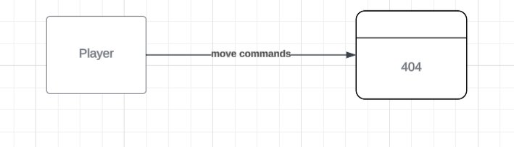
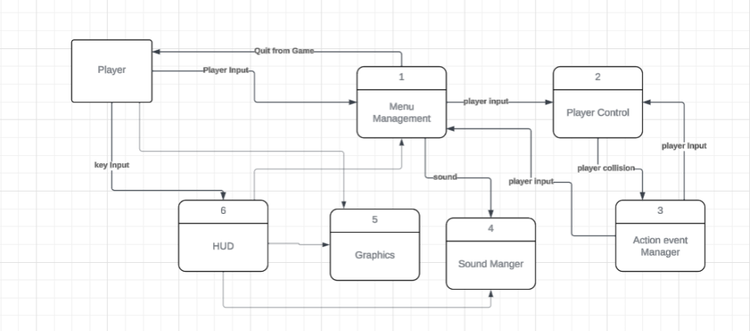
LEVEL 0 DIAGRAM

Slide 15

Individual Use cases
1. Shubham Gupta
2. Upal Kundu
2. Sam
3. Jishnu
4. Owen
5. Aditya
6. Nikki

Slide 16

TL 01 – Shubham GIT Manager
Role: I will be responsible for the sound and music playing in the game.
Priority: GIT: High;
Sound and music: Moderate
Complexity - Moderate

Slide 17

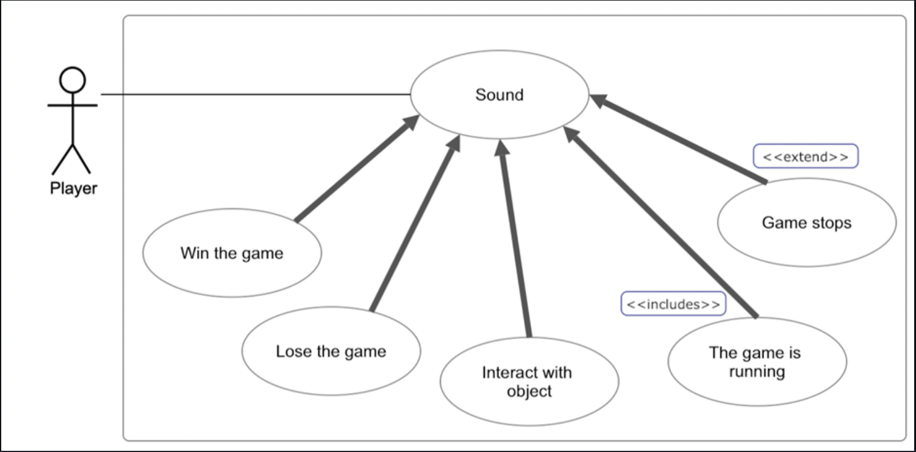
SHUBHAM (Case Diagram)

Slide 18
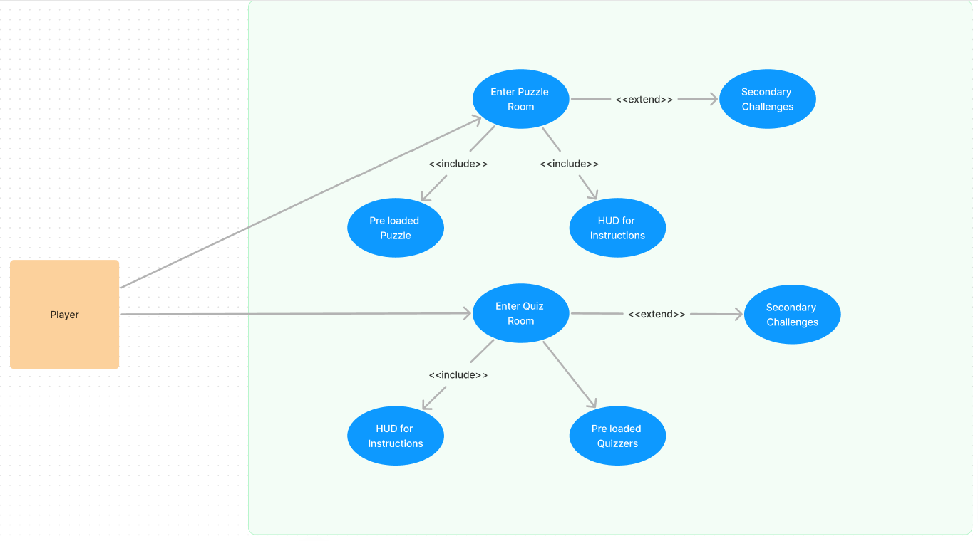
Upal Kundu TL -02
🧑‍💻 Features and Responsibilities:
Features:
🧩 Puzzle Game: Design and implement Modern Puzzle interface with 404 text, this is going to be a mirror puzzle and such, hard to solve.
🤔 Quiz Game: Connect GPT-4 API for quiz question generation, user answer evaluation.
⚙️Integration: Help my team integrate each scene/challenges into game.
📈 Priority: Medium (Other work like screen and other challenges can go in parallel)
🔏Complexity: Simple to Medium (Might be complex to design and integration with frontend)
Case Diagram

Slide 19
TL 02 – Sam Action Event Manager
Red – High Priority
Orange – Medium Priority
Handle Collisions:
Collision with Objects
Collision with Door
Collision with Wall
Collision with Enemy
State and Animation Management:
Idle ---> Idle Animation
Moving ---> Moving Animation
Highly complex due to multiple dependencies
Level Manager
Low complexity. Dependency: Player Movement

Slide 20
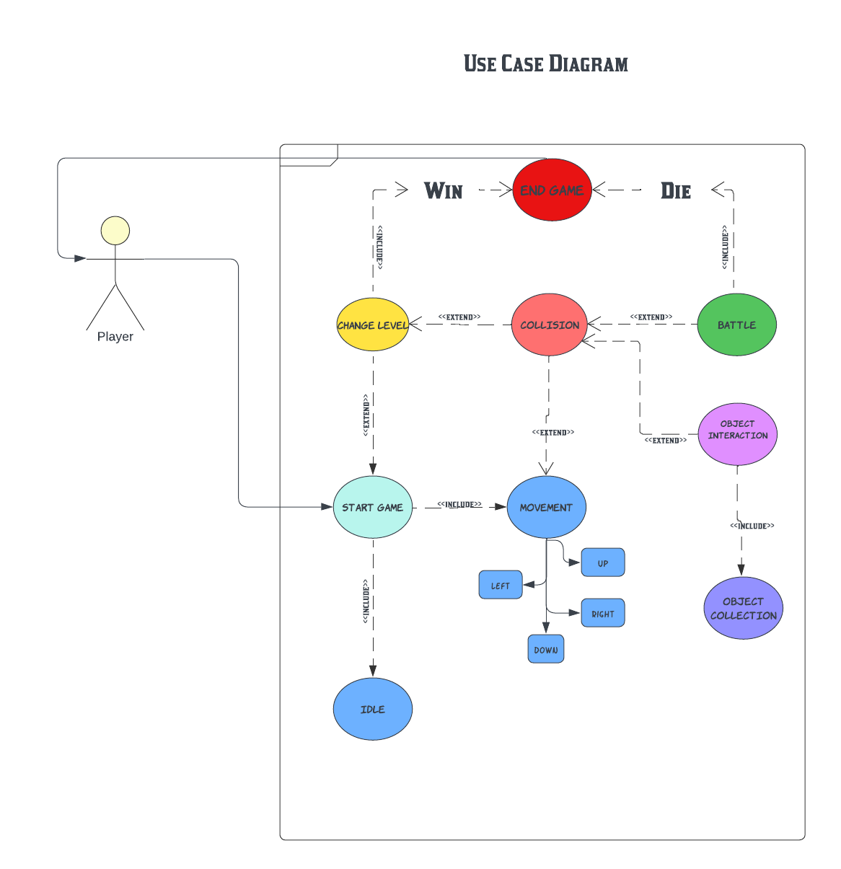

S A M

Slide 21
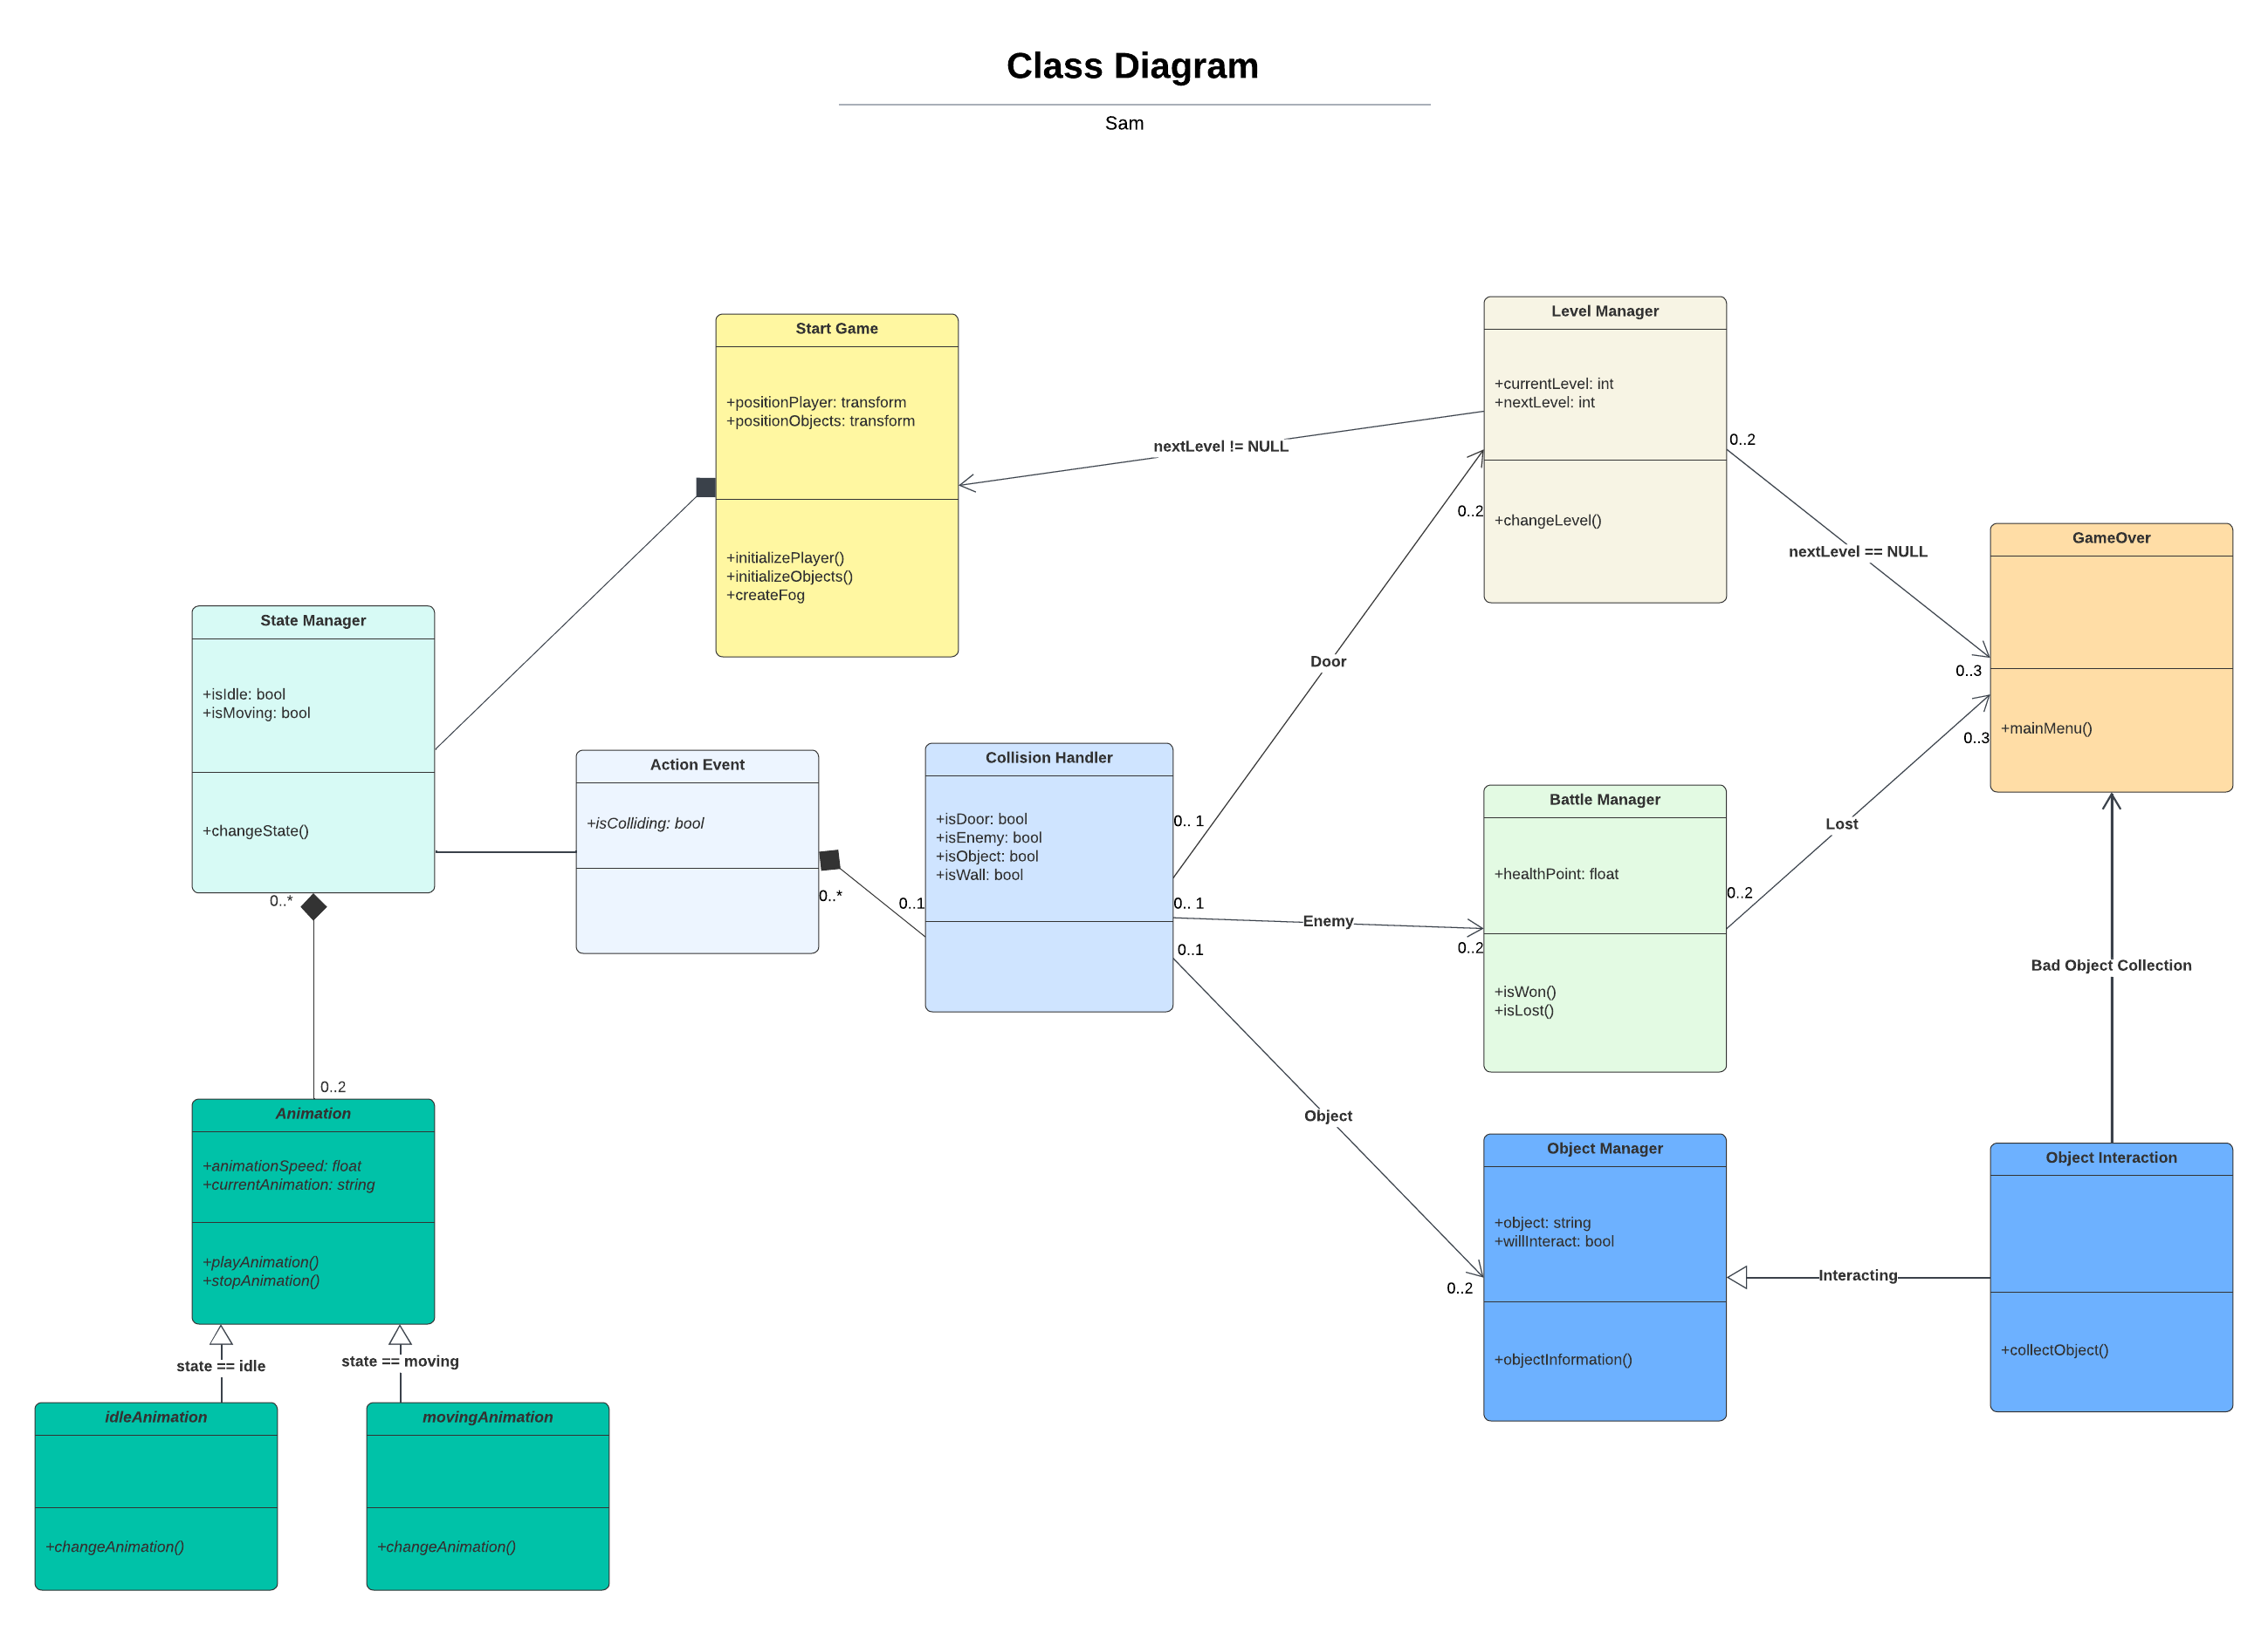

Slide 22

MENU MANAGEMENT
Jishnuvardhan Karpuram (TL-03)

Slide 23

RESPONSIBILITIES:
Create the Menu’s, buttons and haptics for the game
Creating enemy character for our game
PRIORITY:
High (‼️) - Because menu’s play crucial part of the game and I feel like they are brain (coz people already used heart) of the game.
The presence of Enemies in Game Worlds causes Tension and gives players motivation for Overcome goals, often through Combat.
COMPLEXITY:
Medium (❗️)

Slide 24

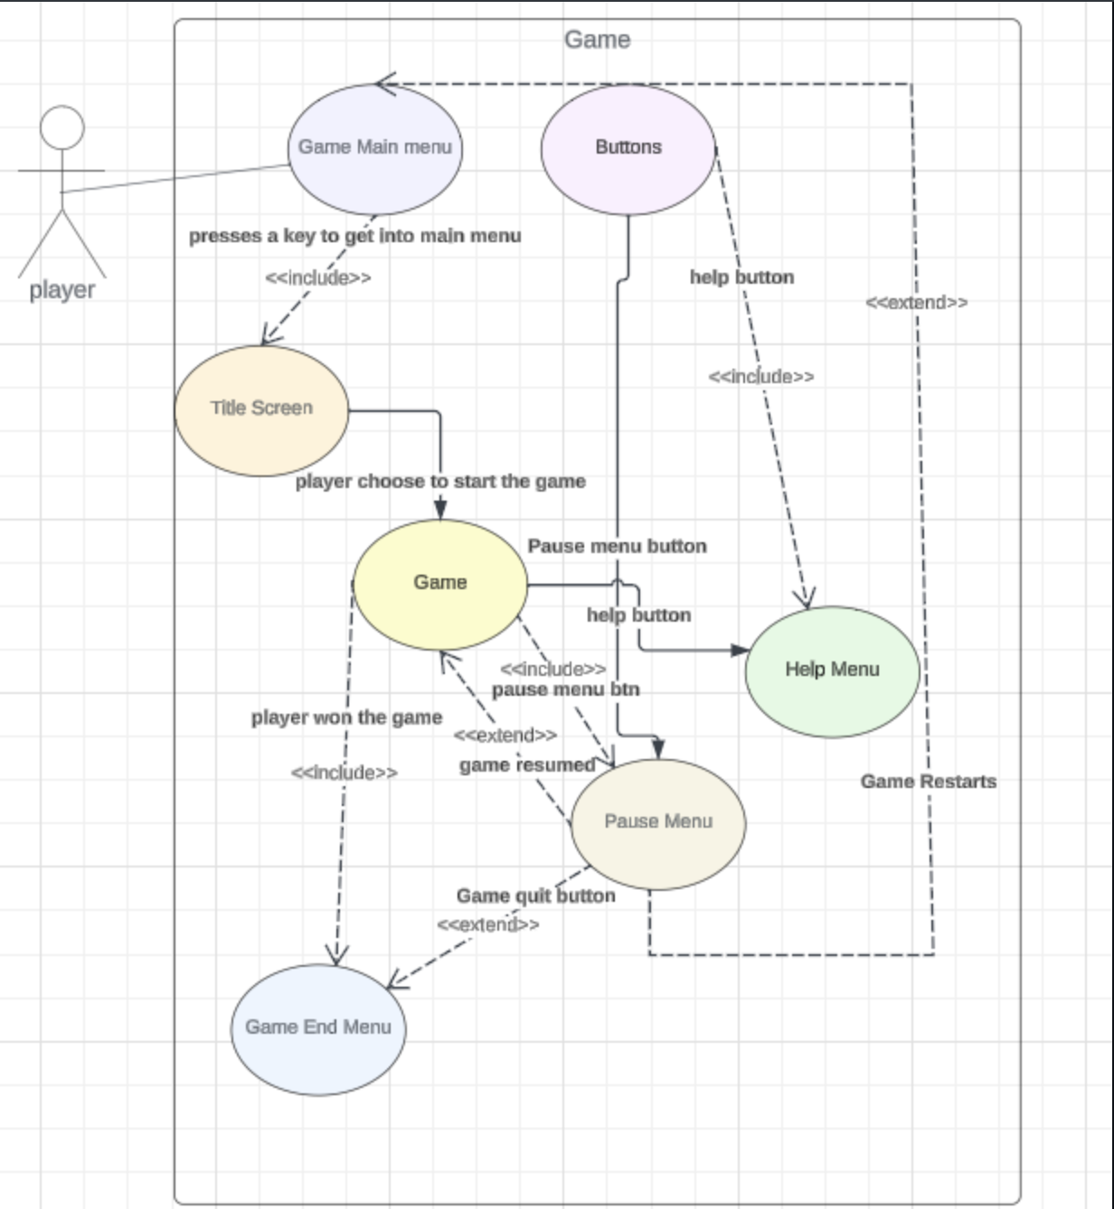
Use Case Diagram:

Slide 25
Owen – HUD & Settings
Access HUD Menu
Access & Examine Clues In Inventory
Access & Change Settings (Graphics & Sound)
Return To Title Screen
Priority:
Medium – Not inherently needed for the game to run
Complexity:
Moderate

Slide 26
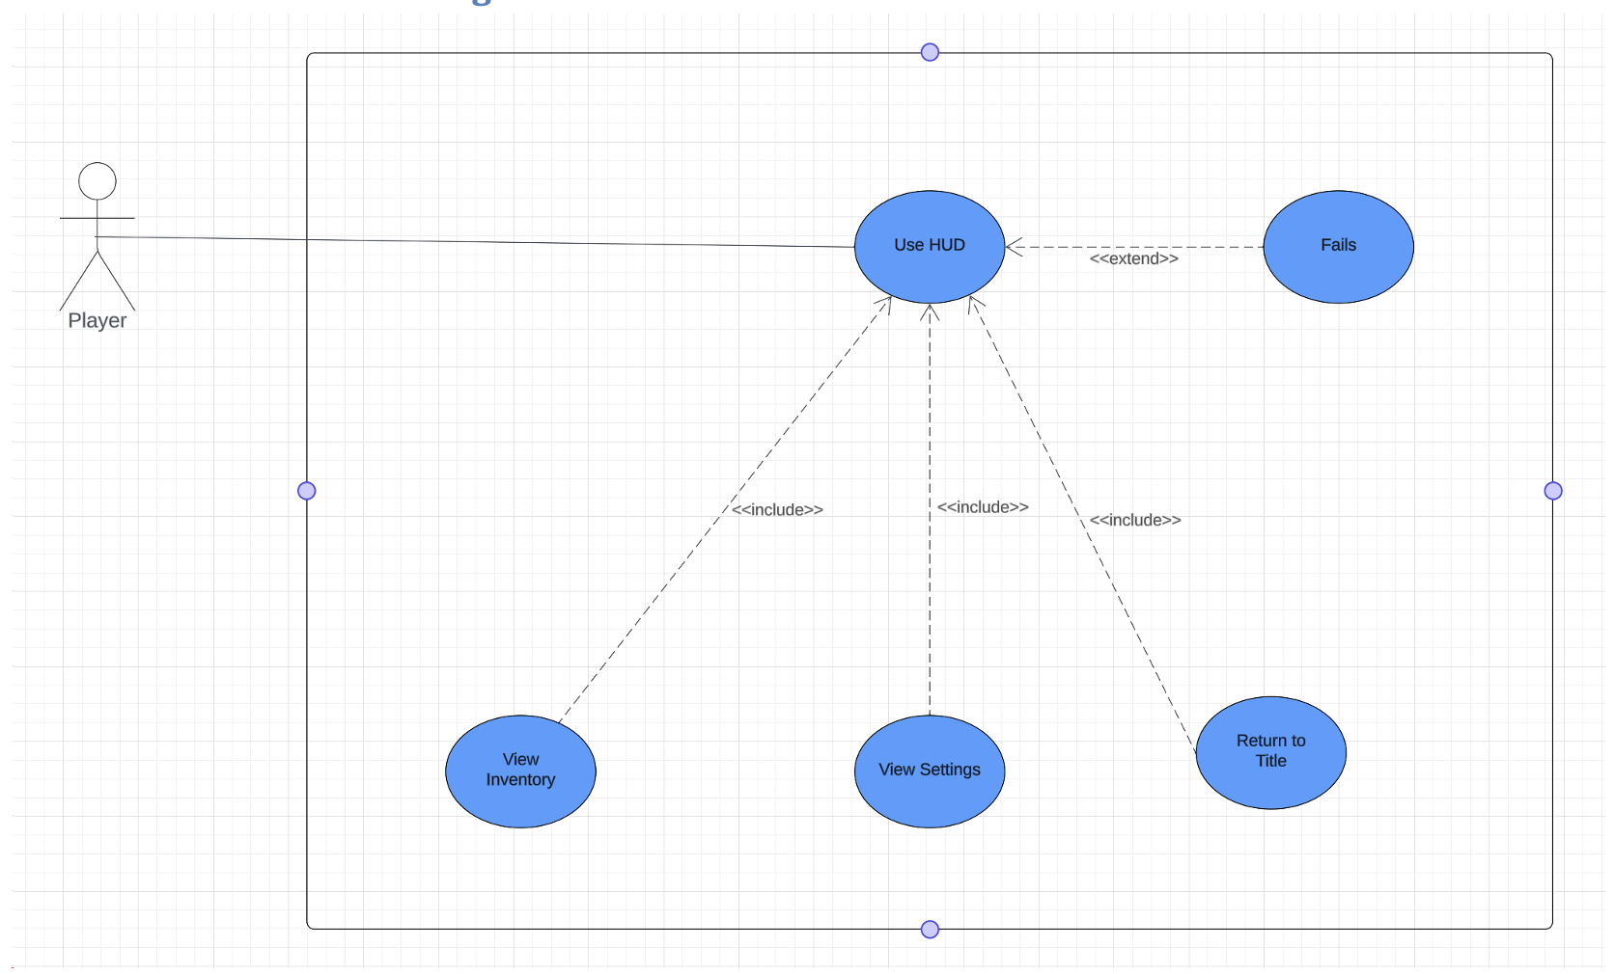
OWEN: HUD & Settings
Use Case

Slide 27

ADITYA(TL05)
Role - Graphics for the Whole Game
I will be responsible for designing and constructing all visual parts of the game, as well as building the level backgrounds.👾
PRIORITY: High❌ COMPLEXITY: A little bit😅

Slide 28

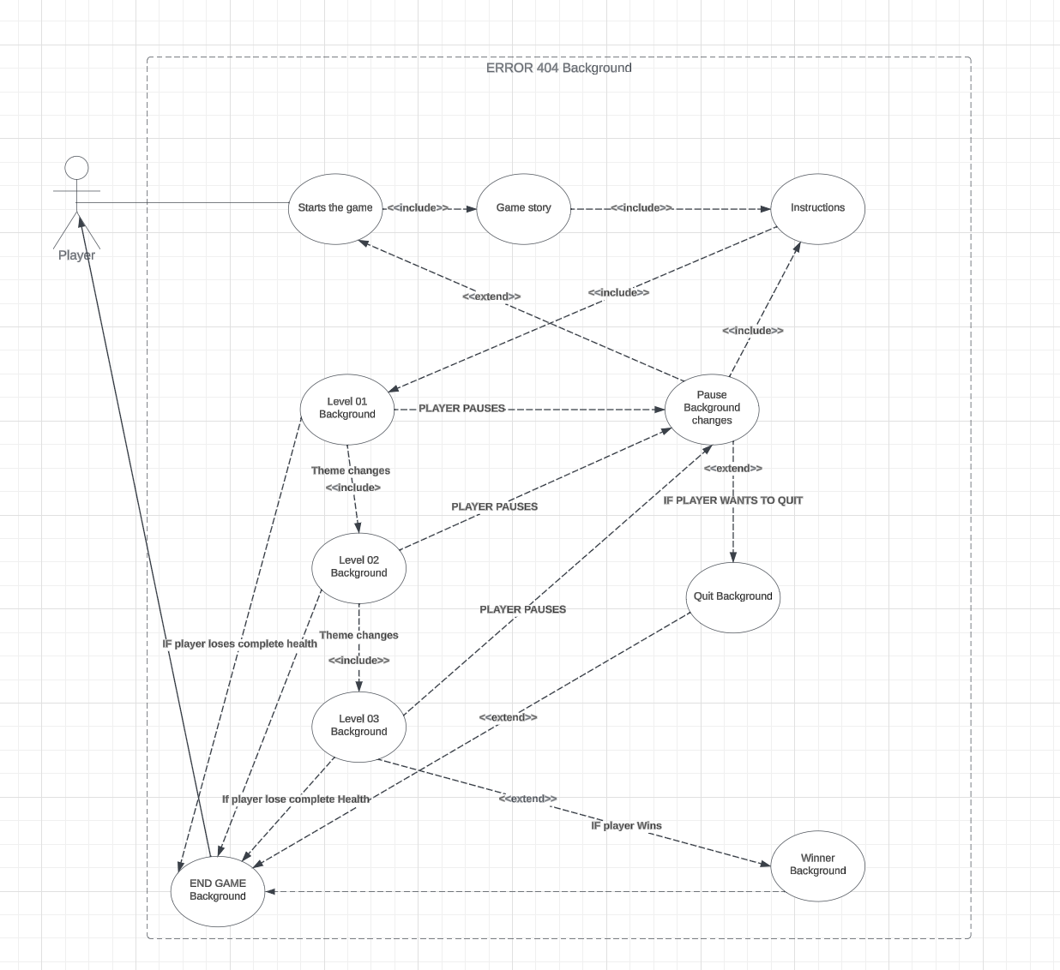
USE-CASE ADITYA

Slide 29

PLAYER CONTROLLER
Nikhitha Kilari (TL-06)

Slide 30

RESPONSIBILITIES:
-Create the Main Player
-Manage the Player Controls
-Handle player Inputs
-Make the game to work on all other devices like mobile and release on different platforms.
PRIORITY:
High- Player is the heart of our game and creating a responsive & intuitive player controller is important.
Medium
COMPLEXITY:
Medium

Slide 31

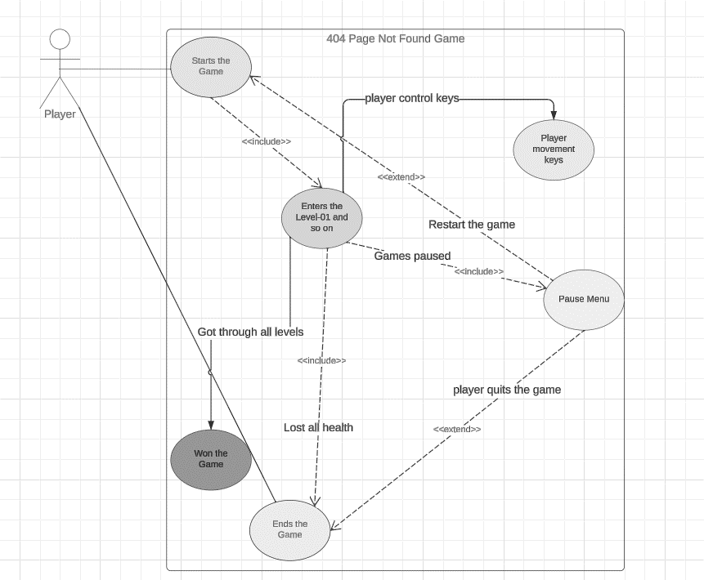
MY USE CASE DIAGRAM

Slide 32
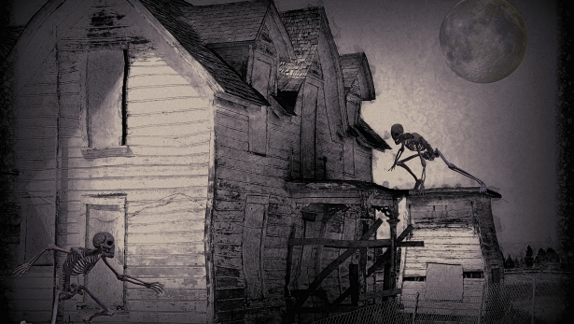
ANY QUESTIONS?☠️
Queries: gupt9166@vandals.uidaho.edu kark5714@vandals.uidaho.edu

